Slide 1
Relational Database Design by ER- to-Relational Mapping

Slide 2
ER-to-Relational Mapping Algorithm
  Step 1: Mapping of Regular Entity Types
  Step 2: Mapping of Weak Entity Types
  Step 3: Mapping of Binary 1:1 Relation Types
  Step 4: Mapping of Binary1:N Relationship Types.
  Step 5: Mapping of Binary M:N Relationship Types.
  Step 6: Mapping of Multivalued attributes.
  Step 7: Mapping of N-ary Relationship Types.

Slide 3
ER-to-Relational Mapping Algorithm
Step 1: Mapping of Regular Entity Types.
  For each regular (strong) entity type E in the ER schema, create a relation R that includes all the simple attributes of E.
  Choose one of the key attributes of E as the primary key for R.
  If the chosen key of E is composite, the set of simple attributes that form it will together form the primary key of R.

Slide 4
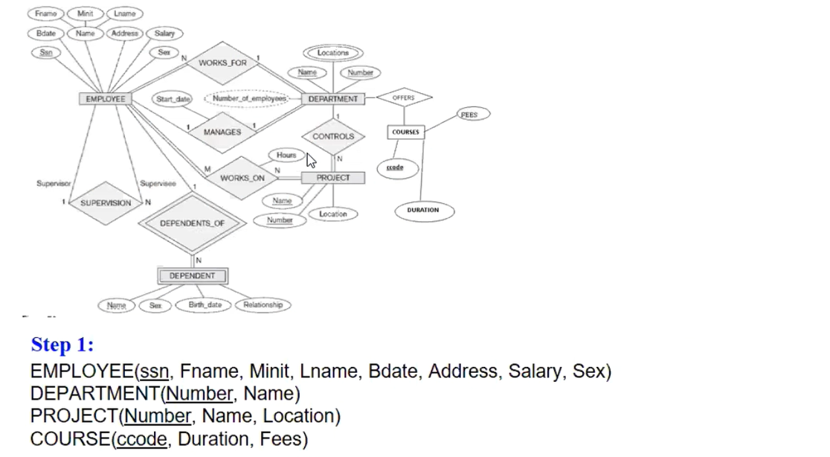
Slide 7- <number>

Slide 5
ER-to-Relational Mapping Algorithm (contd.)
Step 2: Mapping of Weak Entity Types
  For each weak entity type W in the ER schema with owner entity type E, create a relation R & include all simple attributes (or simple components of composite attributes) of W as attributes of R.
  Also, include as foreign key attributes of R the primary key attribute(s) of the relation(s) that correspond to the owner entity type(s).
  The primary key of R is the combination of the primary key(s) of the owner(s) and the partial key of the weak entity type W, if any.

Slide 6
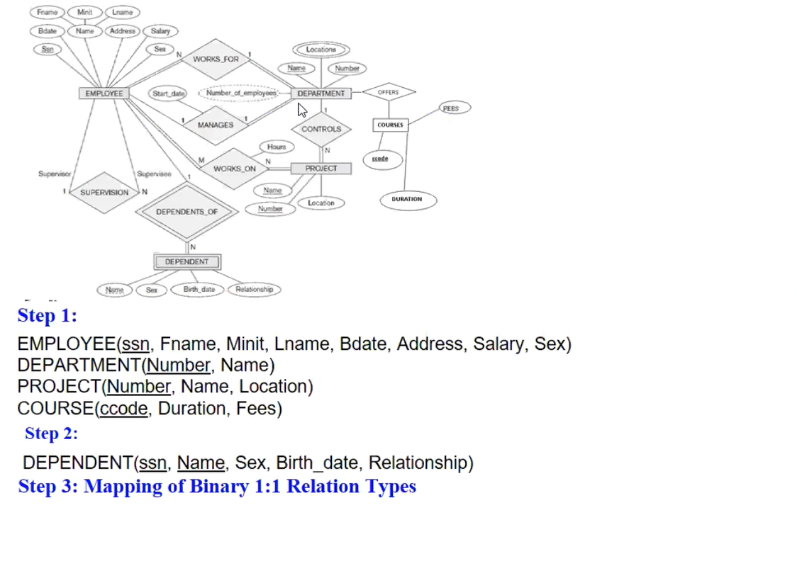
Slide 7- <number>

Slide 7
ER-to-Relational Mapping Algorithm (contd.)
Step 3: Mapping of Binary 1:1 Relation Types
  For each binary 1:1 relationship type R in the ER schema, identify the relations S and T that correspond to the entity types participating in R.
  Foreign Key approach: Choose one of the relations-say S-and include a foreign key in S the primary key of T. It is better to choose an entity type with total participation in R in the role of S.
    Example: 1:1 relation MANAGES is mapped by choosing the participating entity type DEPARTMENT to serve in the role of S, because its participation in the MANAGES relationship type is total.

Slide 8
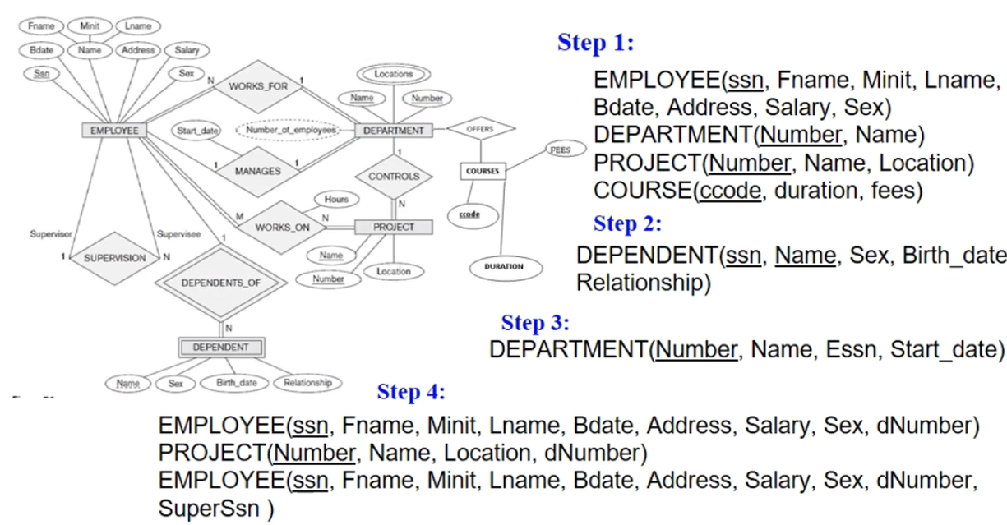
Slide 7- <number>

Slide 9
ER-to-Relational Mapping Algorithm (contd.)
Step 4: Mapping of Binary 1:N Relationship Types.
  For each regular binary 1:N relationship type R, identify the relation S that represent the participating entity type at the N-side of the relationship type.
  Include as foreign key in S the primary key of the relation T that represents the other entity type participating in R.
  Include any simple attributes of the 1:N relation type as attributes of S.

Slide 10
Slide 7- <number>

Slide 11
ER-to-Relational Mapping Algorithm (contd.)
Step 5: Mapping of Binary M:N Relationship Types.
  For each regular binary M:N relationship type R, create a new relation S to represent R.
  Include as foreign key attributes in S the primary keys of the relations that represent the participating entity types; their combination will form the primary key of S.
  Also include any simple attributes of the M:N relationship type (or simple components of composite attributes) as attributes of S.

Slide 12
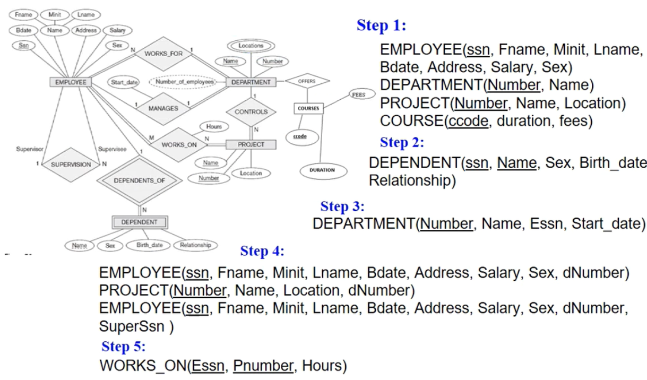
Slide 7- <number>

Slide 13
ER-to-Relational Mapping Algorithm (contd.)
Step 6: Mapping of Multivalued attributes.
  For each multivalued attribute A, create a new relation R.
  This relation R will include an attribute corresponding to A, plus the primary key attribute K-as a foreign key in R-of the relation that represents the entity type of relationship type that has A as an attribute.
  The primary key of R is the combination of A and K. If the multivalued attribute is composite, we include its simple components.

Slide 14
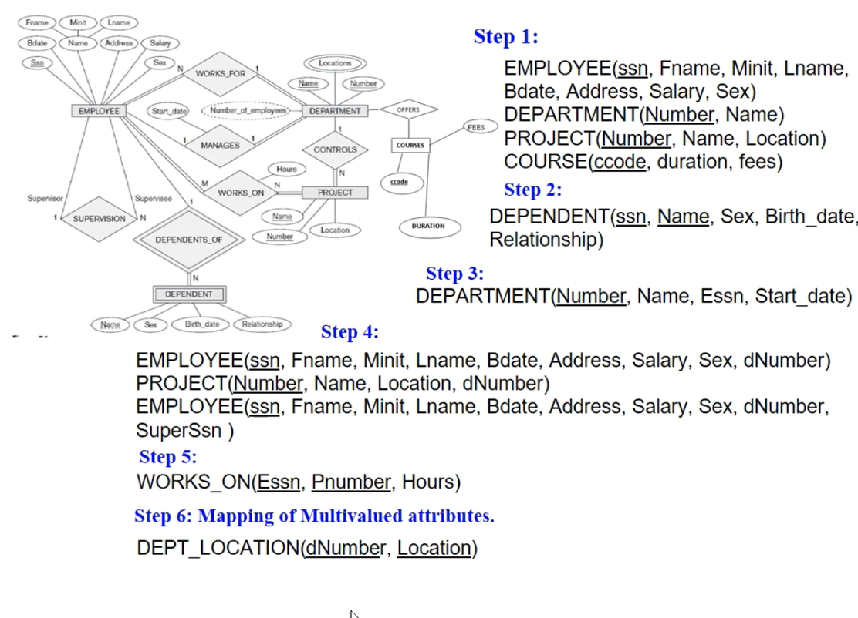
Slide 7- <number>

Slide 15
ER-to-Relational Mapping Algorithm (contd.)
Step 7: Mapping of N-ary Relationship Types.
  For each n-ary relationship type R, where n>2, create a new relation S to represent R.
  Include as foreign key attributes in S the primary keys of the relations that represent the participating entity types.
  Also include any simple attributes of the n-ary relationship type (or simple components of composite attributes) as attributes of S.

Slide 16

Ternary relationship types: The SUPPLY relationship.

Slide 17

Mapping the n-ary relationship type SUPPLY from Figure 4.11a.

Slide 18
Summary of Mapping constructs and constraints
Correspondence between ER and Relational Models
ER Model Relational Model
Entity type “Entity” relation
1:1 or 1:N relationship type Foreign key (or “relationship” relation)
M:N relationship type “Relationship” relation and two foreign keys
n-ary relationship type “Relationship” relation and n foreign keys
Simple attribute Attribute
Composite attribute Set of simple component attributes
Multivalued attribute Relation and foreign key
Value set Domain
Key attribute Primary (or secondary) key

Slide 19
Exercise
COMPANY database keeps track of a company’s employees, departments, and projects. The company is organized into departments. Each department has a unique name, a unique number, and a particular employee who manages the department.
We keep track of the start date when that employee began managing the department. A department may have several locations.
A department controls a number of projects, each of which has a unique name, a unique number, and a single location.
We store each employee’s name, Social Security number,2 address, salary, sex (gender), and birth date. An employee is assigned to one department, but may work on several projects, which are not necessarily controlled by the same department.

Slide 20
Exercise….
We keep track of the current number of hours per week that an employee works on each project. We also keep track of the direct supervisor of each employee (who is another employee).
We want to keep track of the dependents of each employee for insurance purposes. We keep each dependent’s first name, sex, birth date, and relationship to the employee.
Each department offers multiple courses which has course-code, fees and duration.

Slide 21
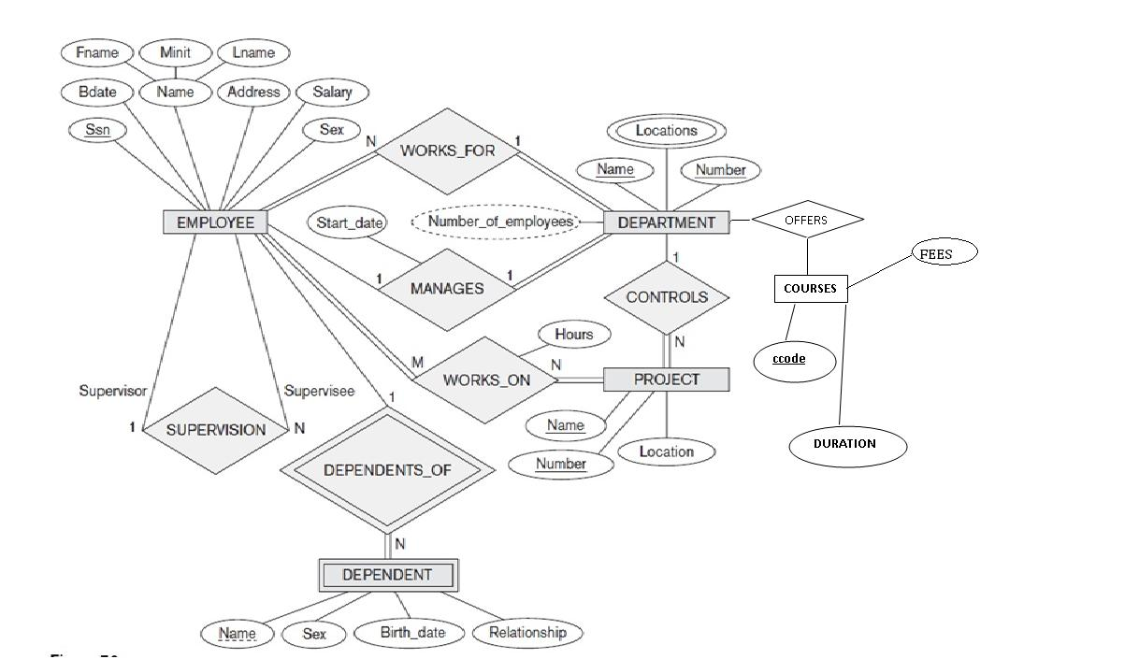

Slide 22
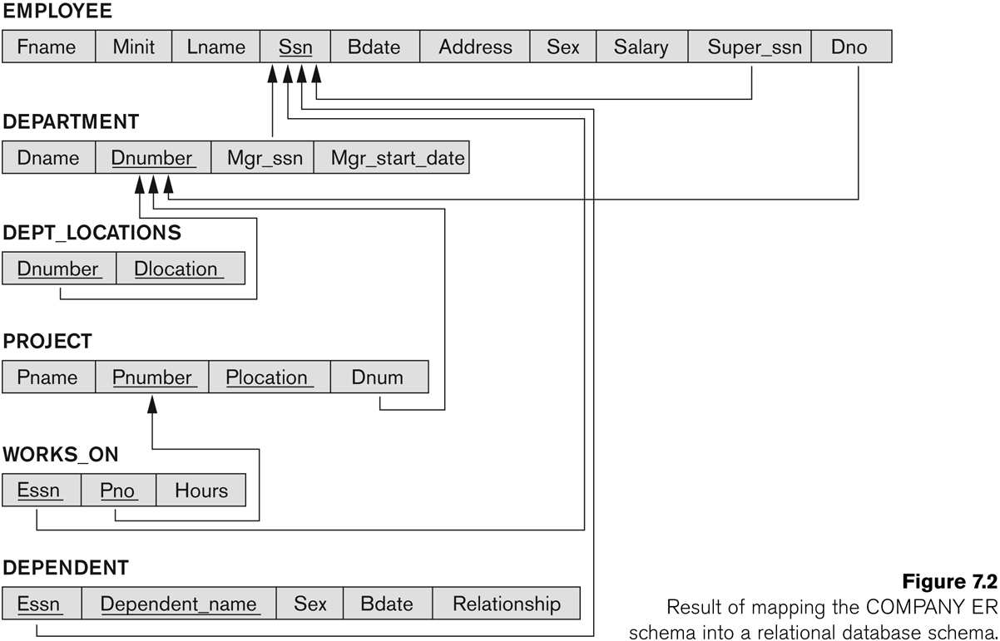
FIGURE 7.2
Result of mapping the COMPANY ER schema into a relational schema.

